Slide 1
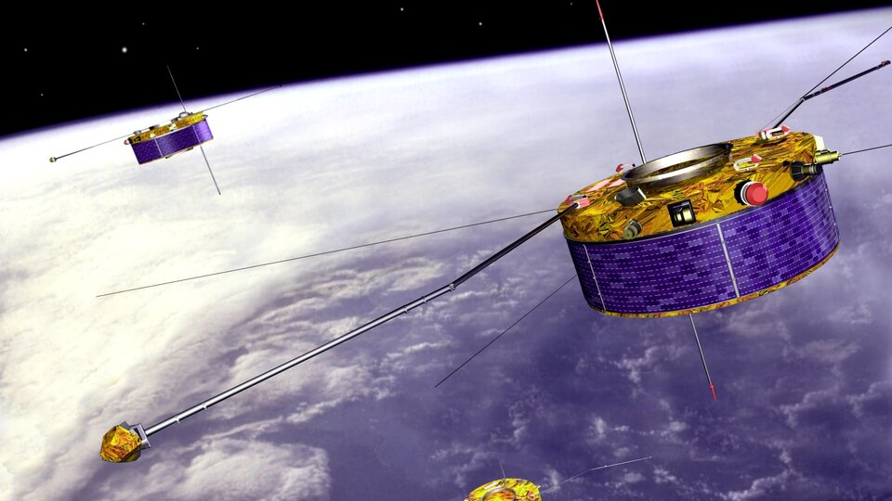
The Cluster Magnetic Field Investigation: Overview of in-flight performance and initial results Annales Geophysicae (2001)
Livia Eichmeyer
Journal Club 26/06/2024

Slide 2
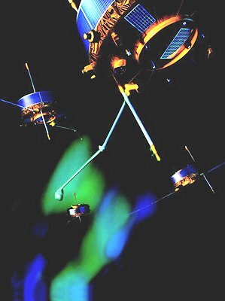
Cluster
Constellation of 4 Spacecraft flying in formation around the Earth
Measuring the magnetic field vector at 4 points enables determination of new parameters such as:
Current density vector
Propagation vectors of waves
Orientation, non-planarity, and motion of boundary surfaces

Slide 3
Cluster Magnetic Field Investigation (FGM)
Primary Objective: Provide accurate measurements of the magnetic field vector at the location of the four Cluster spacecraft
Why?
Magnetic fields provide the basic physical reference system for the transport of momentum and energy in space plasma.
Boundaries between plasmas of different origin are recognised primarily through their signatures in magnetic field observations.
Wave phenomena in the plasma are ordered with respect to the underlying magnetic field.

Slide 4
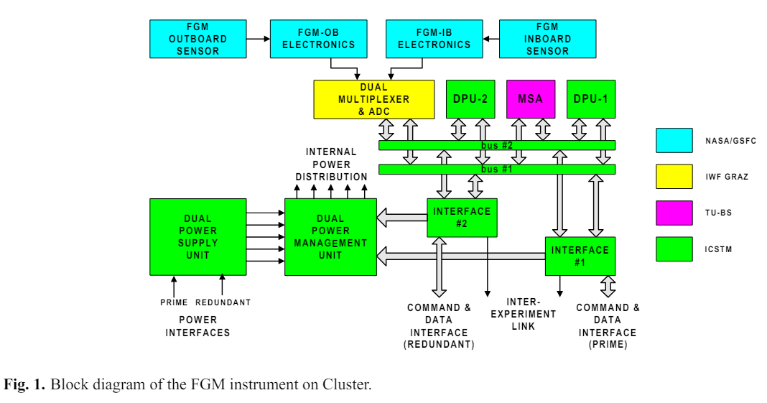
The FluxGate Magnetometer (FGM) Instrument
Consists of two triaxial fluxgate magnetic field sensors on one of the two radial booms of the spacecraft, and an electronics unit on the main equipment platform
Either of the two magnetometer sensors can be used as the primary sensor for the main data stream from the instrument.
In normal operations, the outboard sensor, located at the end of the 5 m radial boom, is designated as the primary source of the data.

Slide 5
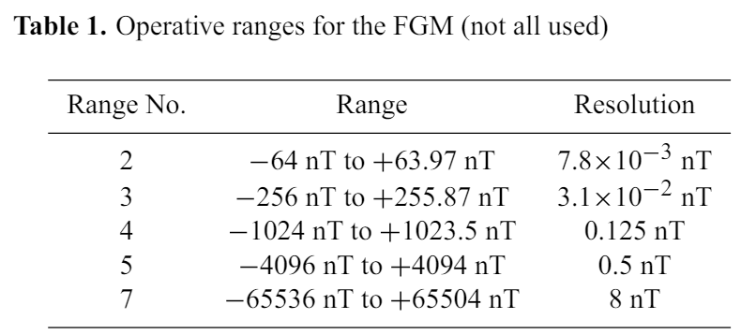
Magnetometer Measurements
The magnetometers can measure the three components of the field in seven ranges.
All three components are measured in the same range
Switching between ranges is either automatic, controlled by the instrument Data Processing Unit (DPU) in flight, or set by ground command.
If any component exceeds 90% of the range, an up-range command is generated.
If all three components are smaller than 12.5% of the range for more than a complete spin period, a down-range command is generated.

Slide 6
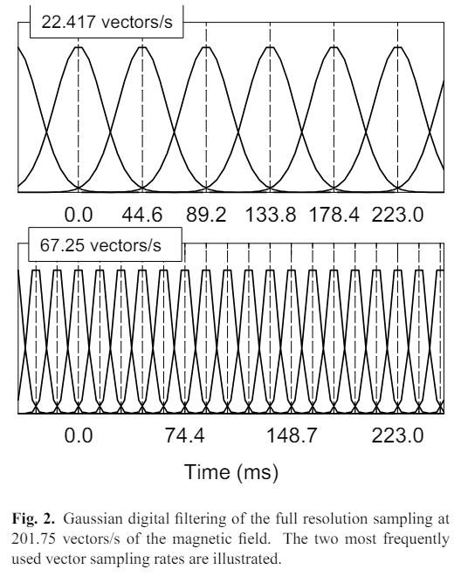
Sampling Rate
The primary sensor uses a clock signal from a 2²³ Hz crystal oscillator internal to the instrument to sample at the rate of 201.793 vectors/s
The CPU encompasses the full bandwidth of data with a Gaussian digital filter to match the rate and bandwidth of the transmitted vectors to the available telemetry rate.

Slide 7
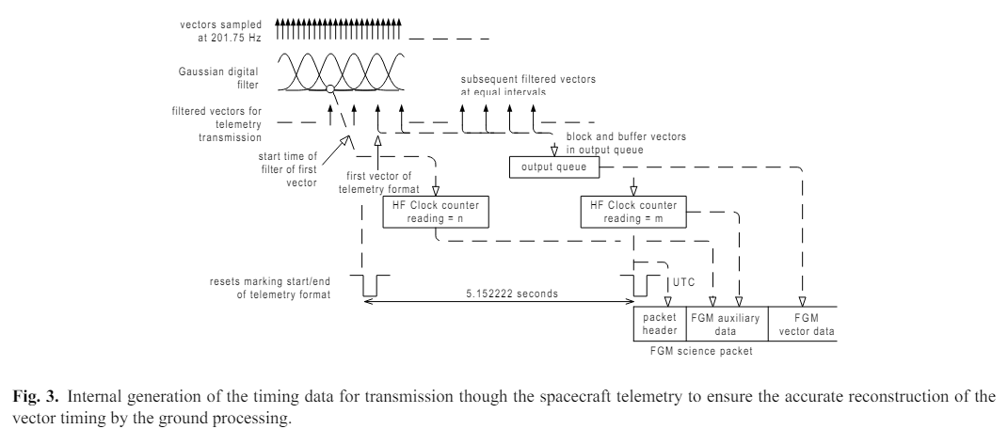

Slide 8
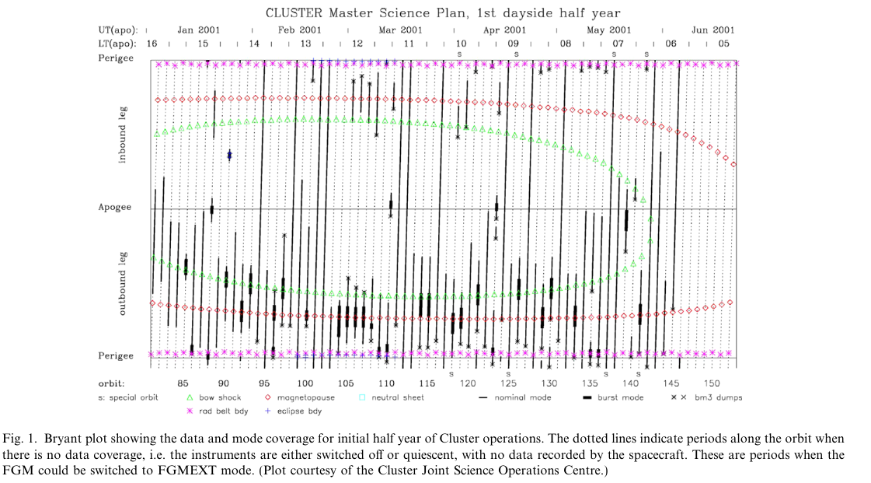
FGM Extended Mode (FGMEXT)
Initially, science data was only available for 50% of each orbit.
Solution: A mode which could store data on-board during non-telemetered intervals.

Slide 9
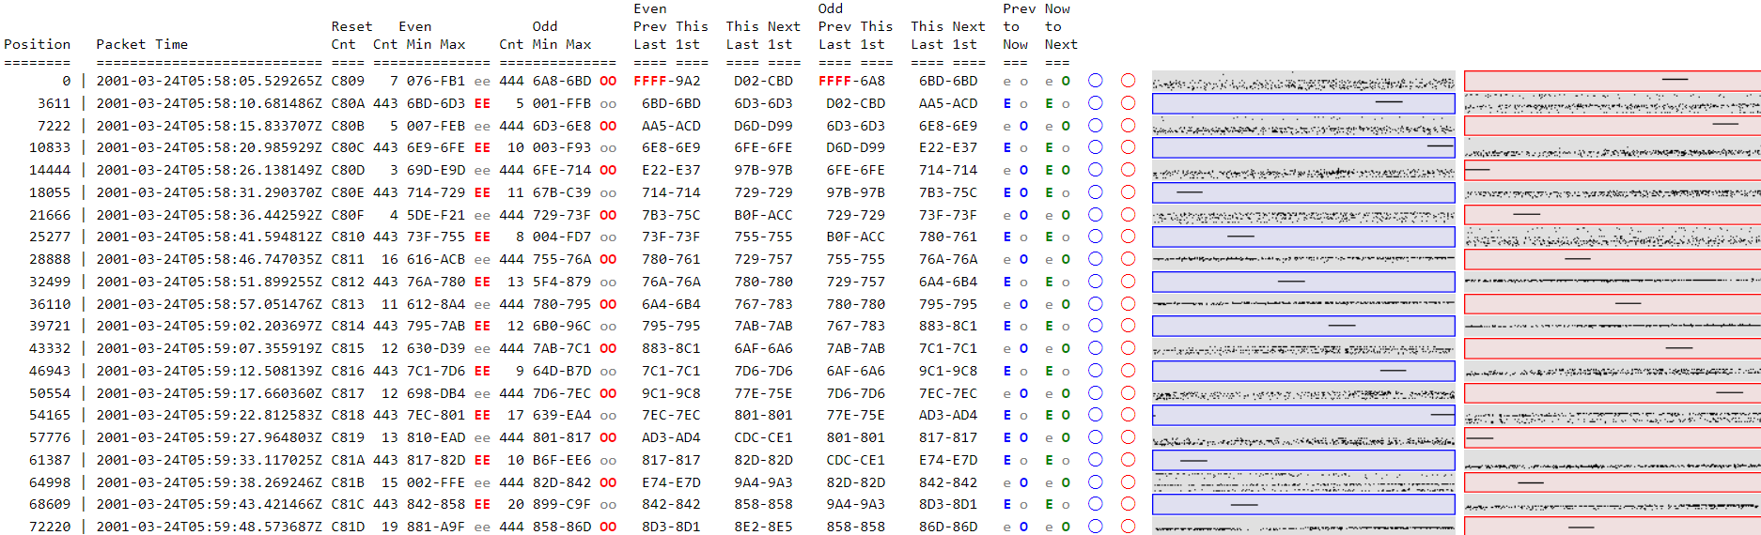
Implementation
Each FGM contains 192Kbytes (96 K words) of MSA memory, which is normally used for capturing short periods of high time-resolution data (approximately 200 samples/s).
At the time of loss of science data coverage, the FGM is commanded into FGMEXT, utilising the MSA to store one averaged vector per spin.
The data is held frozen until the next scheduled burst-memory downlink.
With this mode an additional 27 h of data can be recovered from non-telemetered periods.

Slide 10
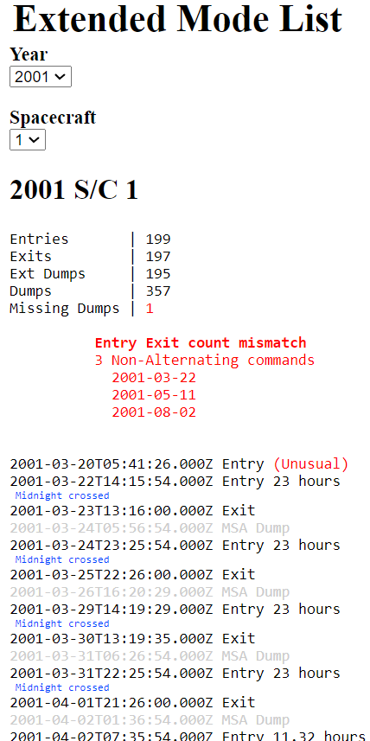
Deriving the Vector Timeline
Unlike Normal Science data packets, there is no relationship between the UTC header time of an Extended Mode downlink packet and the time stamp of any vector in the Extended Mode data.
Instead, the time difference between them is determined by the length of the Extended Mode period and the timing of the BM3 dumps.
The UTC time of the first vector from the Extended Mode packet is taken as the time when the instrument was commanded into Extended Mode.
The timeline for all subsequent vectors is then extrapolated based on an assumed spin period.

Slide 11
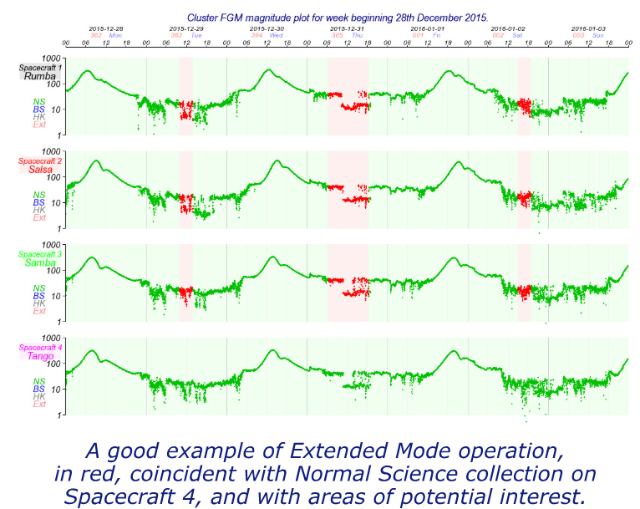
Calibration techniques for magnetometers implementing on-board de-spinning algorithms (2008)
Each Cluster Fluxgate Magnetometer can deliver low resolution de-spun magnetic field vectors through the operation of the on-board Micro Structure Analyzer memory.
The corresponding operating mode, called Extended Mode (FGMEXT), is designed for periods in-flight when there is no science telemetry such as during eclipse operations and spacecraft manoeuvres.
The mode was used extensively during the period 2001–2002 before the implementation of full coverage over the whole of the length of the Cluster orbits.

Slide 12
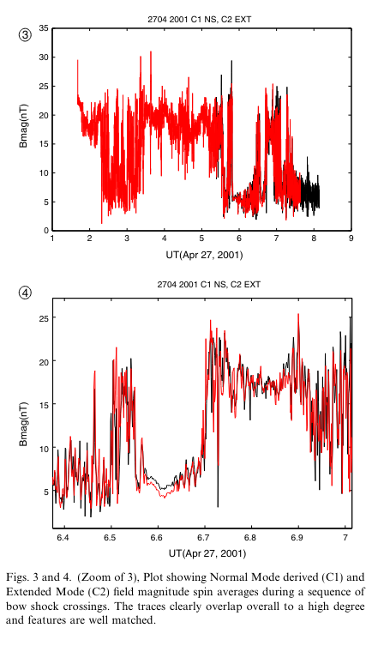
The Extended Mode Dataset
A reasonably large Extended Mode dataset exists, but as this mode was installed in-flight, and not tested on the ground, recovery of the de-spun vector timeline and its associated calibration is non-trivial.
Validation of the Extended Mode data was performed through analysis of a number of special ‘crossmode’ intervals whereby the FGM instruments were operated in different modes on different spacecraft.

Slide 13
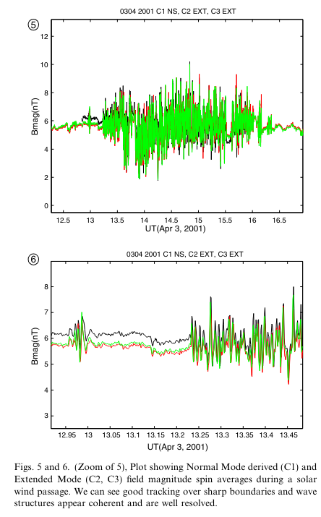
The result of this analysis demonstrates that the Extended Mode data is of usable quality for the purposes of global surveys and that generation of a fully processed Extended Mode dataset would make a worthy addition to the existing FGM datasets.
More detailed timing analysis of the cross-mode intervals is required to place an absolute limit on the Extended Mode vector’s time stamp accuracy.
Following this it is the intention of the FGM team to incorporate this dataset into the Summary Parameter database.

Slide 14
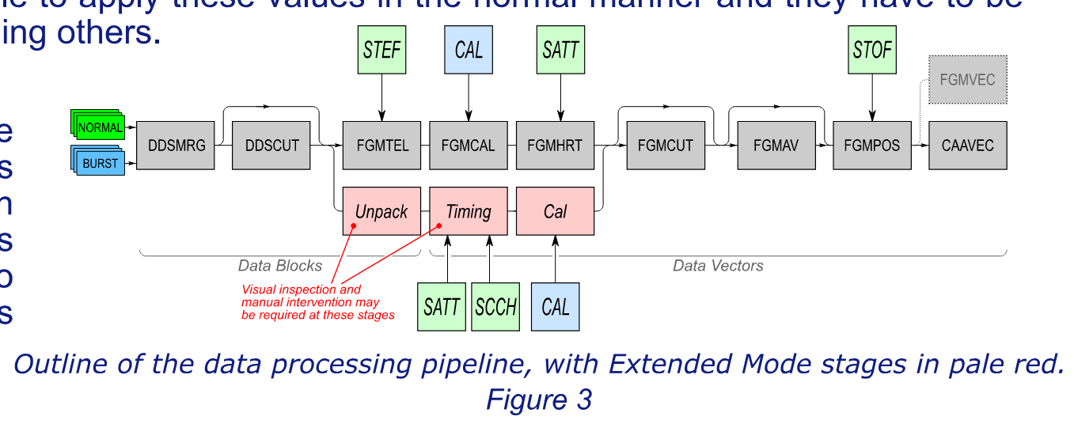
Challenges: Missing Packets, Calibration, Significant Manual Intervention

